Slide 1
Visual Recommender - Books
Nischal Samji – Arizona State University

Slide 2
Motivation
Highly Personalized Recommendation Systems
Users caught in a box !!!
Non – Personal Recommender
Chance To Explore

Slide 3
Audience
General Public interested in reading books
Market Analytics

Slide 4
Research Questions
Trends in reading Books
What Makes a Book Popular?
Finding a Co-Relation between popular books
Effective but Simple Recommender

Slide 5
Data Sources
Popular Book Lists eg: Amazon Top – 100, Goodreads, NY Best Sellers
Goodreads API
Amazon API – for book information

Slide 6
Data Collection
User Comments – Sentiment Analysis
Read/ Started Reading Date Data
User Shelves Data from Bookreads API
Using Python and Bookreads API
Mongodb for Storage

Slide 7
Data Cleaning
Comments from Other Languages
Single Word/ Single Sentence Comments
Punctuations
Preparing a proper csv/ json

Slide 8
Data Analysis
Removal of Stop Words
User Comments – NLTK – Python, Naïve Bayes Classifier to analyze sentiment
Training Data -
3000 user comments
Recommended, Not – Recommended
No. of Reviews
Challenges - “The Kite-runner made me cry. I cannot pick myself up after reading this”

Slide 9
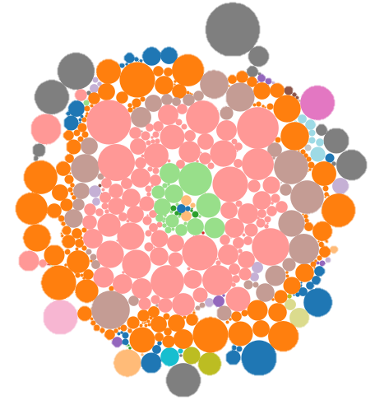
Prototyping
Tableau
Patterns in Trends

Slide 10
Answers
Books made into Movies – Highly Popular
Classics – Highly Acclaimed
Fiction – Highly Popular
Fiction and Young Adult Books – High Correlation

Slide 11
Recommender System
Books Ranked based on Criteria
Features - Pages, hasSeries, No. Of Reviews, Demographics
Closest Ranked among the Particular Genre
General Closeness in Ranks

Slide 12
Future Scope
Addition of More Books
Including More Features – Age, Other Demographic Data
More Sentiments
Better Ranking Algorithms

